Slide 1

FINAL PROJECT PYTHON 1
By: Kadyrzhanov Dias

Slide 2
Table of contents
01
02
03
Purpose
Libraries
Web page

Slide 3
01
Purpose

Slide 4
Purpose
The project should analyze the news page of the coin, the name of which was transmitted through the input on the web page. Then all the paragraphs are added to the database and display the summarized paragraphs using the hugging face on the website page.

Slide 5
02
Libraries

Slide 6
Libraries
flask (https://flask.palletsprojects.com/en/2.0.x/)
flask_sqlalchemy (https://flask-sqlalchemy.palletsprojects.com/en/2.x/)
requests (https://pypi.org/project/requests/)
beautifulSoup (https://www.crummy.com/software/BeautifulSoup/bs4/doc/)
Huggingface(pip install transformers)
https://www.digitalocean.com/community/tutorials/processing-incoming-request-data-in-flask
To work with form data

Slide 7
03
Web Page

Slide 8
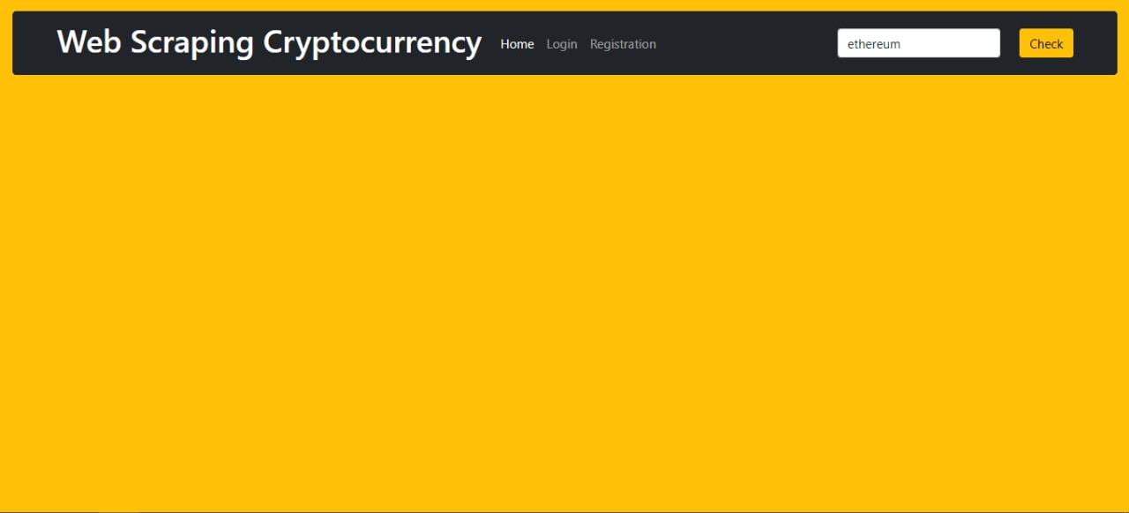
To enter coin name

Slide 9
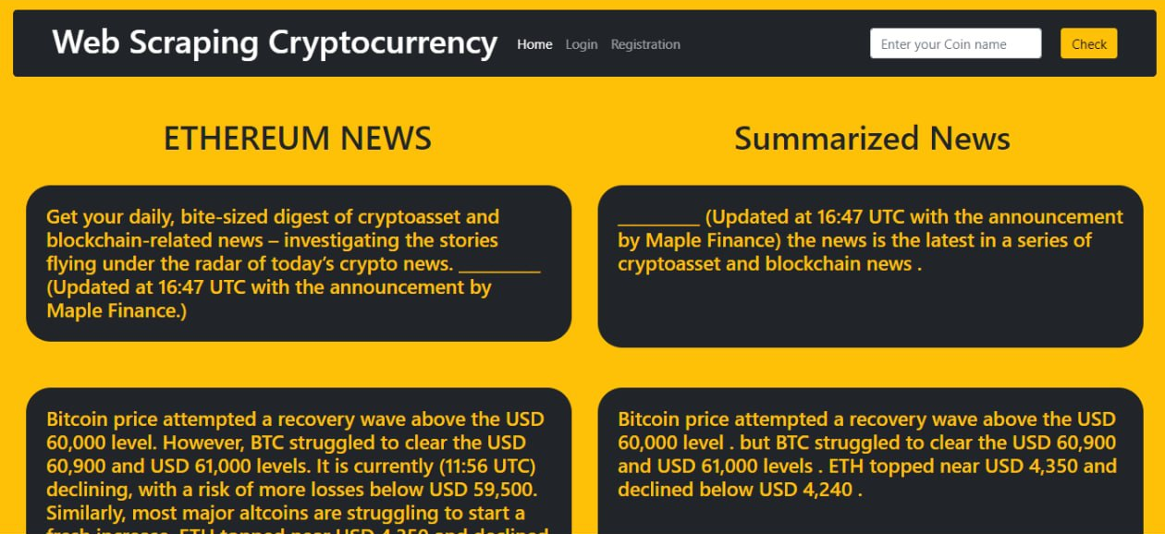
Full paragraph
Summarized paragraph
Entered coin name

Slide 10

Thanks!
Instructor: Magzhan Ikram
Astana IT University
2021

